Slide 1
10 June 2020
1

Slide 2

APPLIED CRYPTOGRAPHY
Lecture 25
2

Slide 3
Modes of Operation
More Security through Input
10 June 2020
3

Slide 4
Overview
The literature divides the symmetric ciphers into two broad categories: stream ciphers and block ciphers.
Although the definitions are normally applied to modern ciphers, this categorization also applies to traditional ciphers.
Although the five modes of operations enable the use of block ciphers for encipherment of messages or files in large units and small units, sometimes pure stream are needed for enciphering small units of data such as characters or bits.
4

Slide 5
Topics discussed in this section
Introduction
Types of Modes of Operation
Stream Cipher Modes of Operation
Block Cipher Modes of Operation
Other Issues
5

Slide 6
Introduction
A mode of operation is a way of encrypting arbitrary-length
messages using a block cipher (i.e., PseudoRandom
Permutation-PRP).
6

Slide 7
Types of Modes of Operations
Stream Cipher
Synchronized
Unsynchronized
Block Cipher
Electronic Code book(ECB)
Cipher Block Chaining (CBC)
Cipher Feedback mode(CFB)
Output Feedback mode(OFB)
Counter mode(CTR)
7

Slide 8
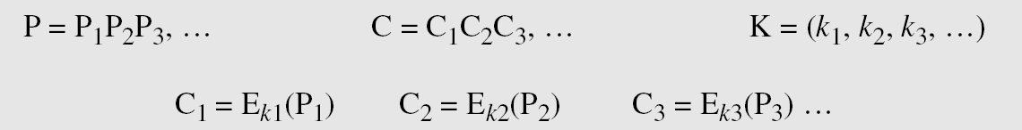
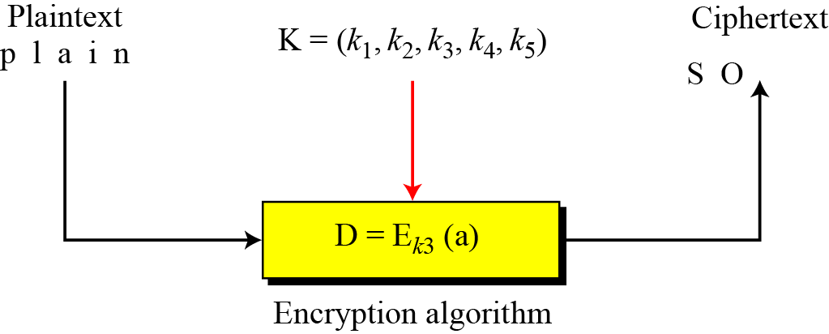
Stream Cipher
Call the plaintext stream P, the ciphertext stream C, and the key stream K.
8

Slide 9
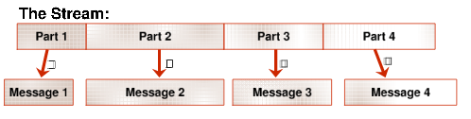
Synchronized mode
The communicating parties use a different part of the stream
output by the stream cipher in order to encrypt each message.
9

Slide 10
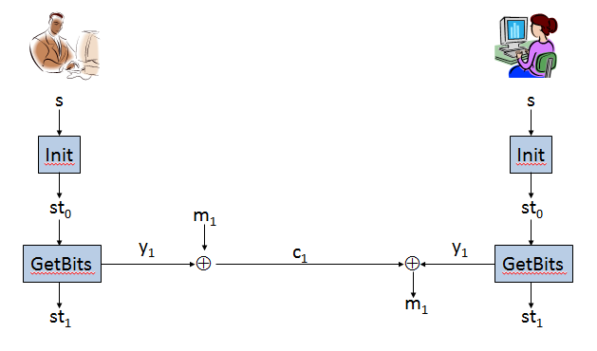
Continued..
This mode is “synchronized“ because both parties need to know
which parts of the stream have already been used in order to
prevent reuse, which is not secure.
10

Slide 11
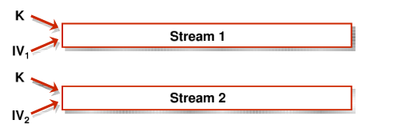
Unsynchronized mode
Encryptions are carried out independently of one another
and the parties do not need to maintain state.
11

Slide 12
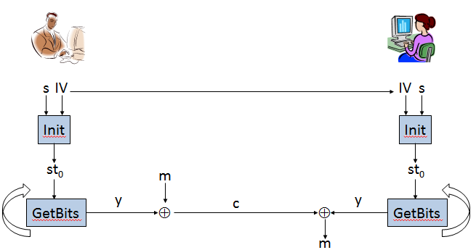
Continued..
In order to achieve security, pseudorandom generator
must be significantly strengthened. Pseudorandom generator
is taking two inputs: a seed sand an initial vector IV of length n.
12

Slide 13
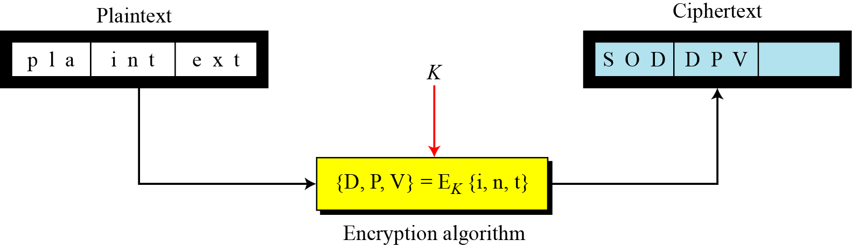
Block Cipher
In a block cipher, a group of plaintext symbols of size m (m > 1) are encrypted together creating a group of ciphertext of the same size. A single key is used to encrypt the whole block even if the key is made of multiple values.
13

Slide 14
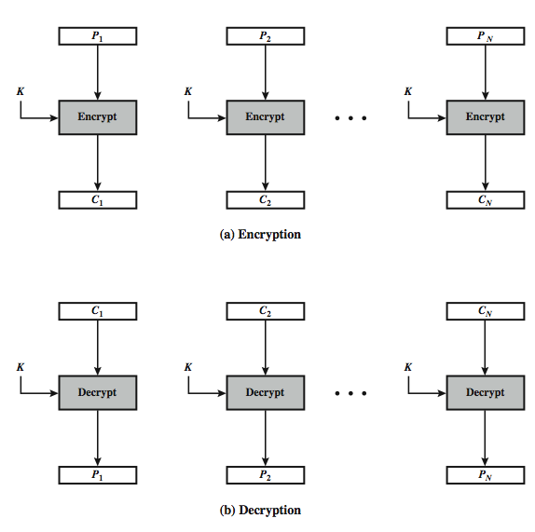
Electronic Code Book(ECB) mode
14

Slide 15
Electronic Code Book(ECB) mode
Message is broken into independent blocks that are encrypted
Each block is a value which is substituted, like a codebook
Each book is encoded independently of the other blocks
Ci=Ek(Pi)
Uses: Secure transmission of single values
15

Slide 16
Advantages and Limitations of ECB
Message repetitions may show in ciphertext
If aligned with message block particularly with data such graphics or
with messages that change very little, which become a code-book
analysis problem.
Weakness is due to the encrypted message blocks being independent
Vulnerable to cut-and-paste attacks
Main use is sending a few blocks of data
16

Slide 17
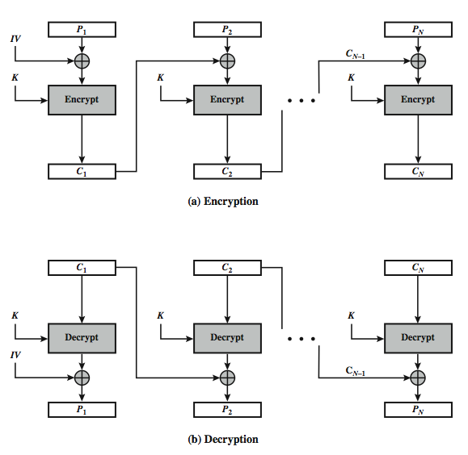
Cipher Block Chaining(CBC) mode
17

Slide 18
Cipher Block Chaining(CBC) mode
Message is broken into blocks
Linked together in encryption operation
Each previous cipher block is chained with current plaintext block
Use Initial Vector(IV) to start process
Ci=Ek(Pi XOR Ci-1)
C-1=IV
IV presents same P from making same C
Uses: Bulk data encryption, authentication
18

Slide 19
Advantages and Limitations of CBC
A ciphertext block depends on all blocks before it, any change to a block affects all following ciphertext blocks... avalanche effect.
Need Initialization Vector (IV) which must be known to sender & receiver if sent in clear, attacker can change bits of first block, by changing corresponding bits of IV hence IV must either be a fixed value (as in EFTPOS) or derived in way hard to manipulate or sent encrypted in ECB mode before rest of message or message integrity must be checked otherwise
19

Slide 20
Cipher Feedback (CFB) mode
message is treated as a stream of bits added to the output of the block cipher result is feed back for next stage
standard allows any number of bits (1,8, 64 or 128 etc) to be feed back denoted CFB-1, CFB-8, CFB-64, CFB-128, etc.
most efficient to use all bits in block (64 or 128)
C_{i} = P_{i} XOR E_{K}(C_{i-1})
C₋₁ = IV
Uses: Stream data encryption , authentication
20

Slide 21
Advantages and Limitations of CFB
Most common stream mode and appropriate when data arrives in bits/bytes
Limitation is need to stall while do block encryption after every
s-bits
The block cipher is used in encryption mode at both ends (XOR)
Errors propagate for several blocks after the error
21

Slide 22
Output FeedBack (OFB) mode
Message is treated as a stream of bits output of cipher is added to message output is then feed back
O_{i} = E_{K}(O_{i-1})
C_{i} = P_{i} XOR O_{i}
O₋₁ = IV
Feedback is independent of message can be computed in advance
Uses: stream encryption on noisy channels
22

Slide 23
Advantages and Limitations of OFB mode
Needs an IV which is unique for each use if ever reuse attacker can recover outputs
OTP can pre-compute bit errors do not propagate more vulnerable to message stream modification, change arbitrary bits by changing ciphertext
23

Slide 24
Continued ..
Sender & receiver must remain in sync only use with full block feedback
Subsequent research has shown that only full block feedback (ie CFB-64 or CFB-128) should ever be used
24

Slide 25
Counter mode(CTR)
a “new” mode, though proposed early on
similar to OFB but encrypts counter value rather than any feedback value
O_{i} = E_{K}(i)
C_{i} = P_{i} XOR O_{i}
Never reused: Must have a different key & counter value for every plaintext block
OTP issue
Uses: high-speed network encryptions
25

Slide 26
Advantages and Limitations of CTR mode
Efficiency
can do parallel encryptions in h/w or s/w
can pre-process in advance of need
good for bursty high speed links
random access to encrypted data blocks
provable security (good as other modes)
never have cycle less than 2^{b}
but must ensure never reuse key/counter values,
otherwise could break (cf OFB)
26

Slide 27
CTR mode
Theorem: If F is a pseudorandom function, then randomized counter
mode has indistinguishable encryptions under a chosen-plaintext attack.
Proof: Randomized counter mode is CPA-secure when a truly random
function is used.
Then prove that replacing the random function by a pseudorandom
function cannot make the scheme insecure.
27

Slide 28
Comparison of different modes
28

Slide 29
Other Issues
Encipherment using symmetric-key block or stream ciphers requires discussion of other issues.
Key Management
Key Generation
10 June 2020
29

Slide 30
Key Management & Key Generation
Alice and Bob need to share a secret key between themselves to securely communicate using a symmetric-key cipher. If there are n entities in the community, n(n − 1)/2 keys are needed.
Different symmetric-key ciphers need keys of different sizes.
The selection of the key must be based on a systematic approach to avoid a security leak.
The keys need to be chosen randomly. This implies that there is a need for random (or pseudorandom) number generator.
10 June 2020
30

Slide 31
Thank You!
Next Class
Mandatory reading for the next class
https://tools.ietf.org/html/rfc3447
10 June 2020
31

Slide 32


Vineetha B
Computer Science and Engineering
PES University, Bengaluru
10 June 2020
32

